Slide 1
Telcom Customer Churn Analysis
-Hai Du

Slide 2
Objective
Identifies the causes for churn and works to resolve those issues
Converts structured and unstructured data/information into meaningful insights

Slide 3
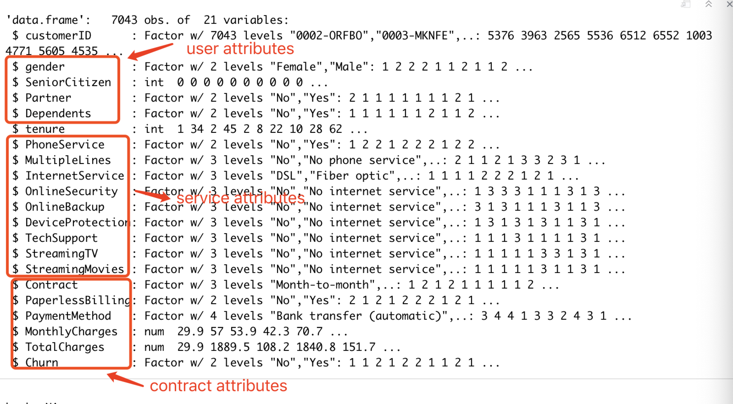
Overview of the Data

Slide 4
Overview of the Data (Customer churn: is the percentage of customers that stopped using company's product or service)
Churn: Whether the customer churned or not (Yes or No)
SeniorCitizen: senior citizen or not (1, 0)
Partner: the customer has a partner or not (Yes, No)
Dependents: Whether the customer has dependents or not (Yes, No)
InternetService: (DSL, Fiber optic, No)
Contract: (Month-to-month, One year, Two year)
PaymentMethod: (Electronic check, Mailed check, Bank transfer (automatic), Credit card (automatic))
MonthlyCharges: The amount charged to the customer monthly
TotalCharges: The total amount charged to the customer
tenure: Number of months the customer has stayed with the company

Slide 5
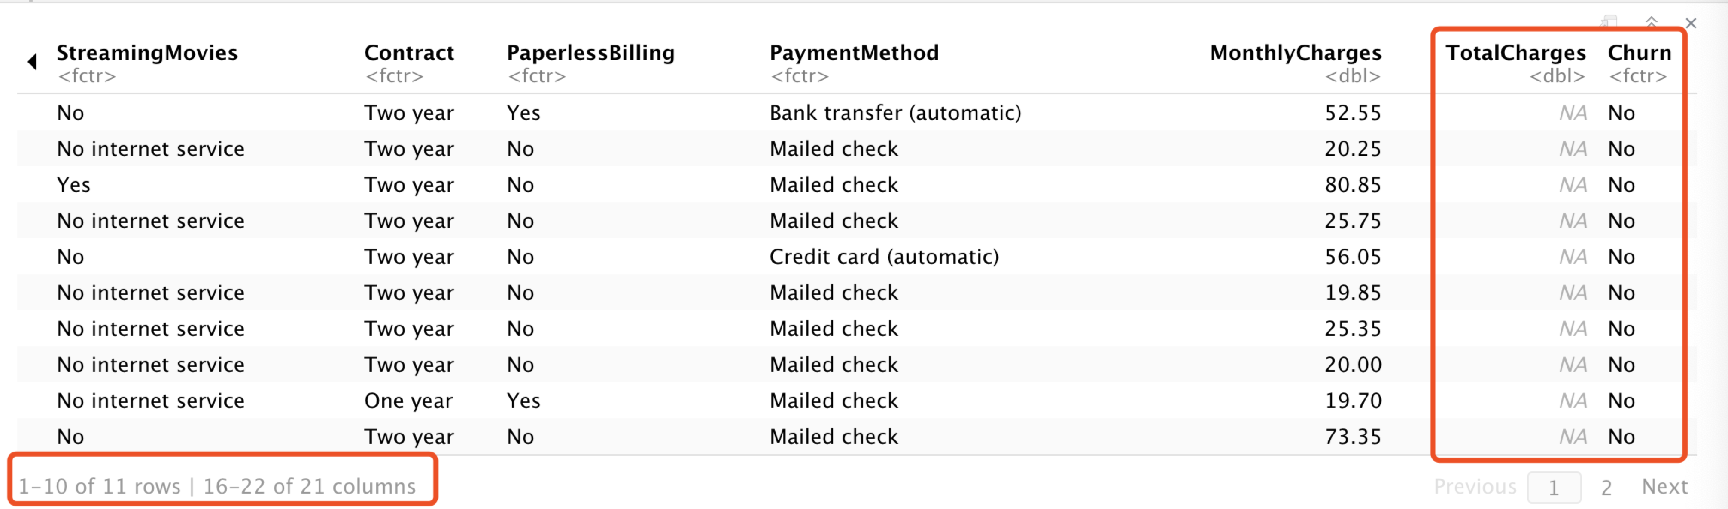
Data Manipulation
Since the number of rows with Na values are very small ( less 1% of the data),
and taking into consideration that all of them are churn=”No”,
which is over-represented in the data. I will just delete those rows from the working data

Slide 6
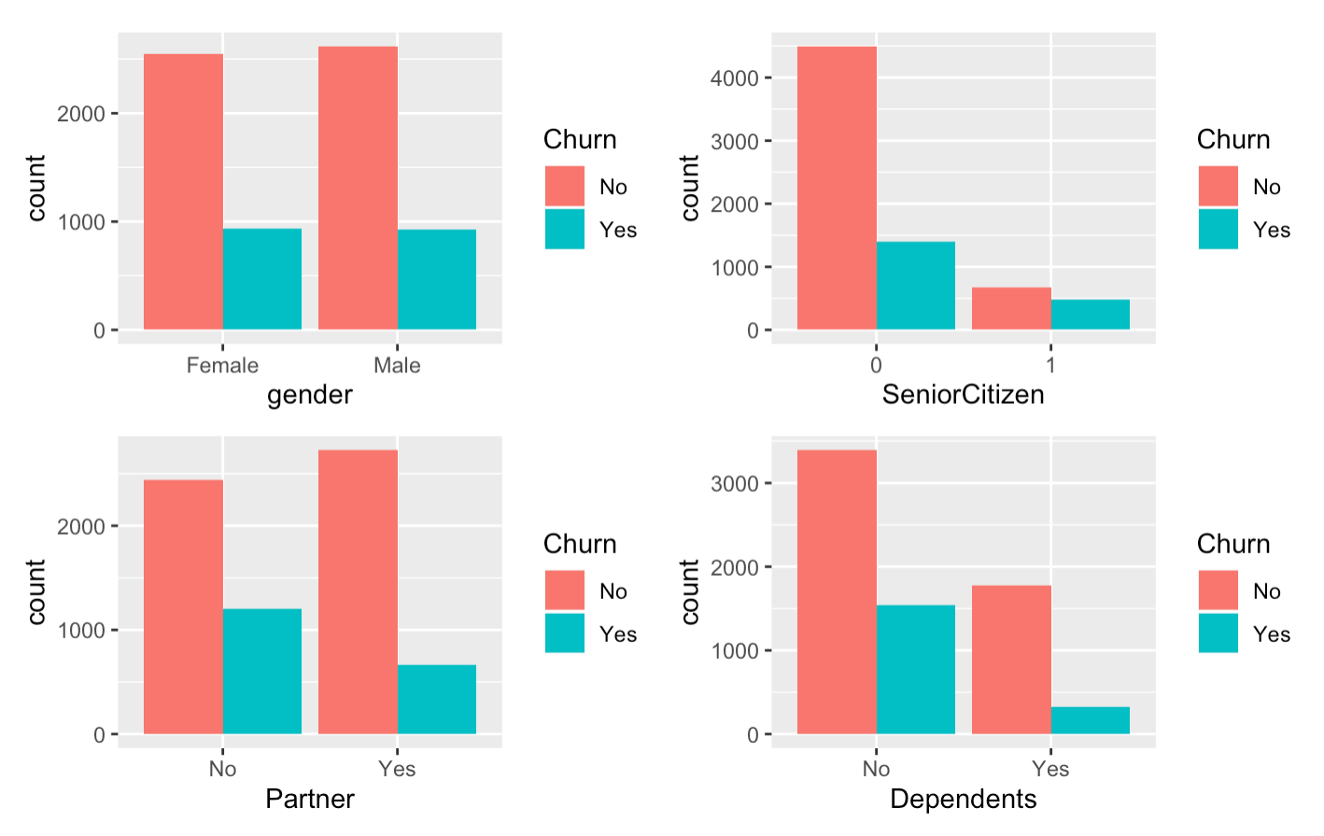
For user attributes, I am interested in the following questions.
Are men more likely to churn than women?
Are senior citizens more likely to churn?
Do individuals with a partner churn more than those without a partner?
Do people with dependents churn more than people that do not have dependents?
Notes:
Well Taking a look plot, the results are similar for gender. Roughly one quarter of the male and female customers churn,
senior citizens and for someone who do not have partner and depends are much more likely to churn., This may be due to the fact that senior citizen may are not interested in these new products, which is also associated with a high mortality rate among the senior citizens
3. It‘s also easy to understand when you have fewer family members and partners, you may have less need for communication services

Slide 7

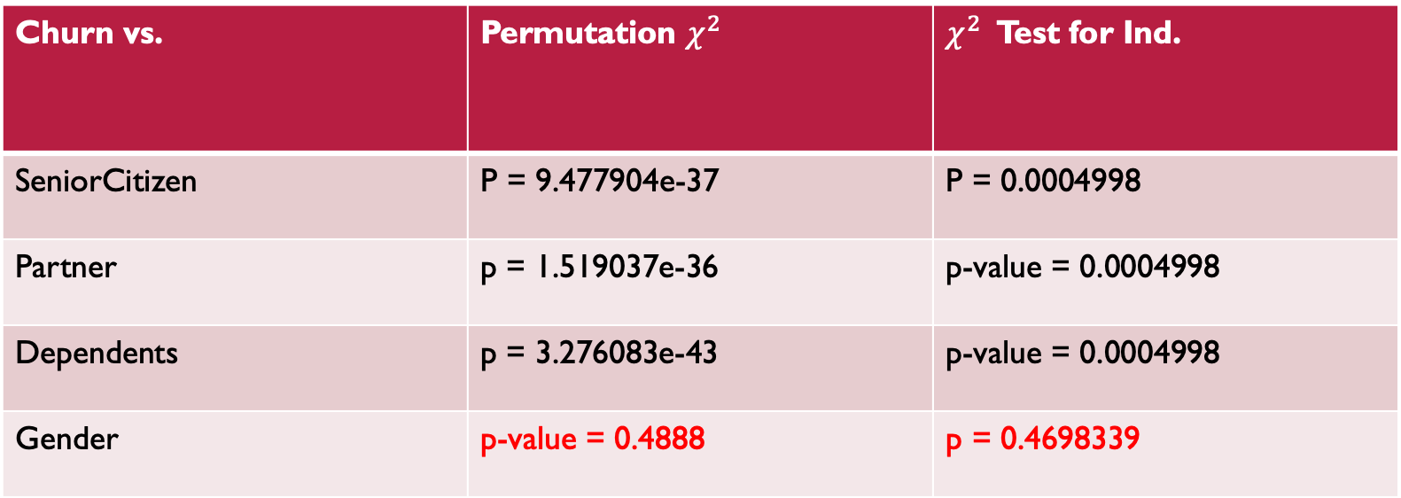
Permutation $χ^{2}$ Test: Churn Vs. Categorical Variables
$H_{0}:$ Churn is not associated with ___ Vs. ${ H}_{0}:$Churn is associated with __
Churn vs. | Permutation $χ^{2}$ | $χ^{2}$ Test for Ind.
SeniorCitizen | P = 9.477904e-37 | P = 0.0004998
Partner | p = 1.519037e-36 | p-value = 0.0004998
Dependents | p = 3.276083e-43 | p-value = 0.0004998
Gender | p-value = 0.4888 | p = 0.4698339

Slide 8
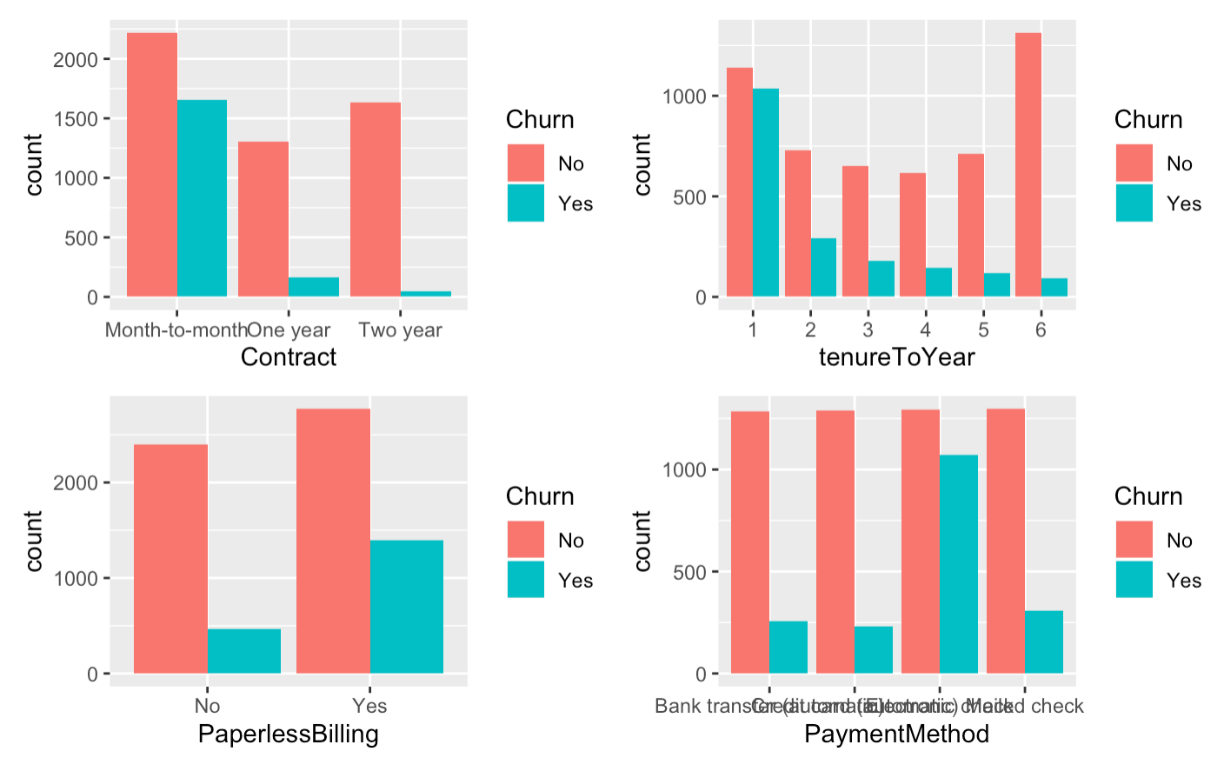
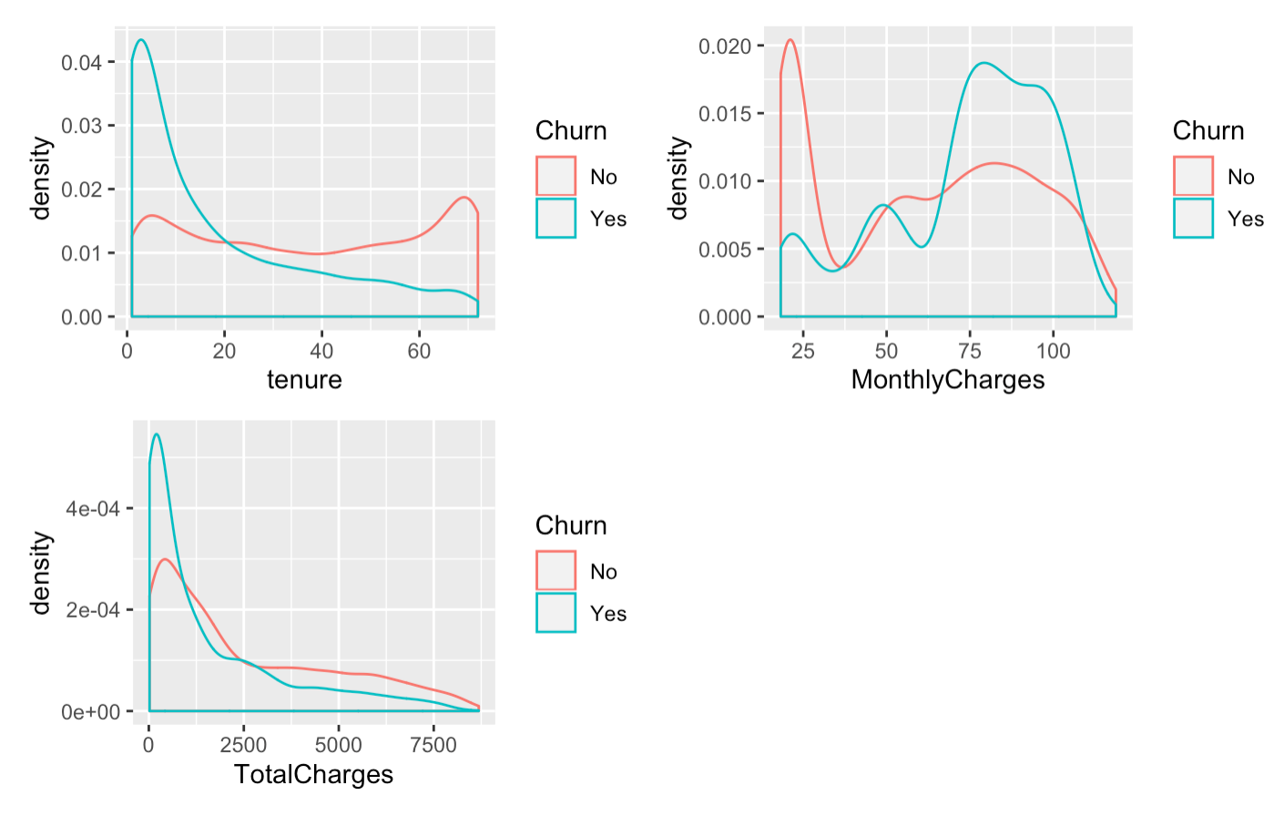
Let look at contract attributes
Notes:
so The longer the Contract period, the less likely to lose users.
The longer the customer stays with the company, the lower the churn rate, but for the first half of the year. The attrition rate is the highest
customer with paperlessbilling are more likely to churn
The payment method of Electronic Check is obviously more likely to lose customers, perhaps because of the convenience of handling business
For tenure, New users are more likely to be lost, that’s reflecting the importance of maintaining existing customer; 2. The higher the monthly charge, the more likely customer will be lose. Especially when monthly charge is between 70-100$

Slide 9
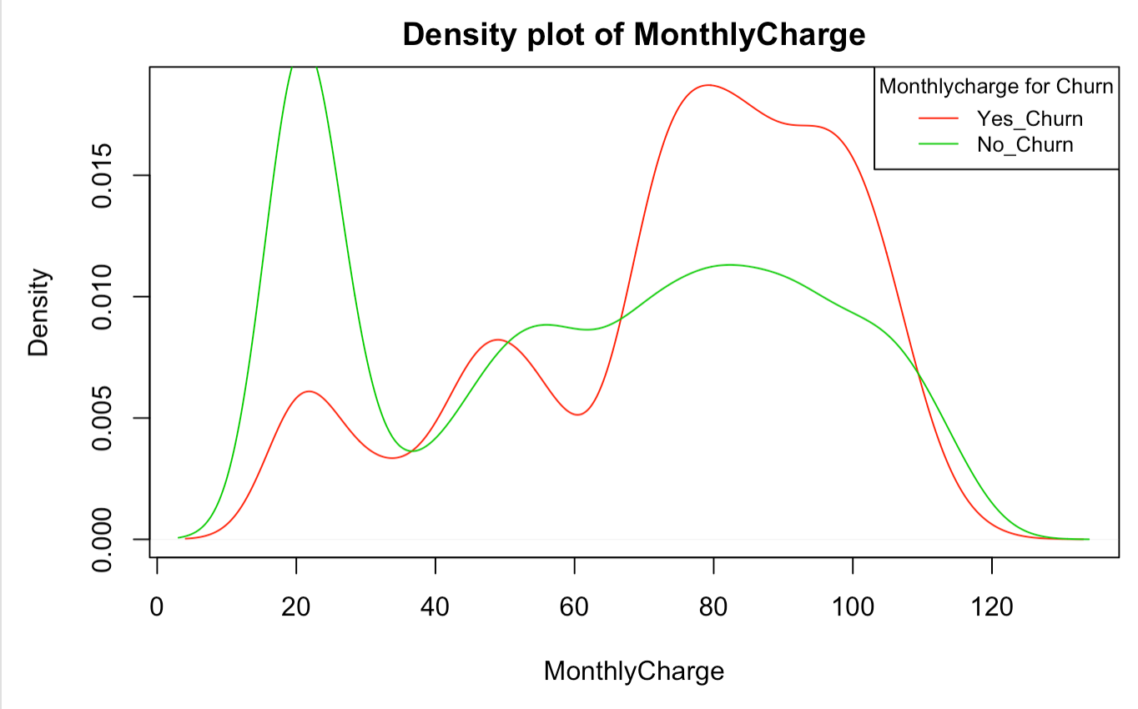
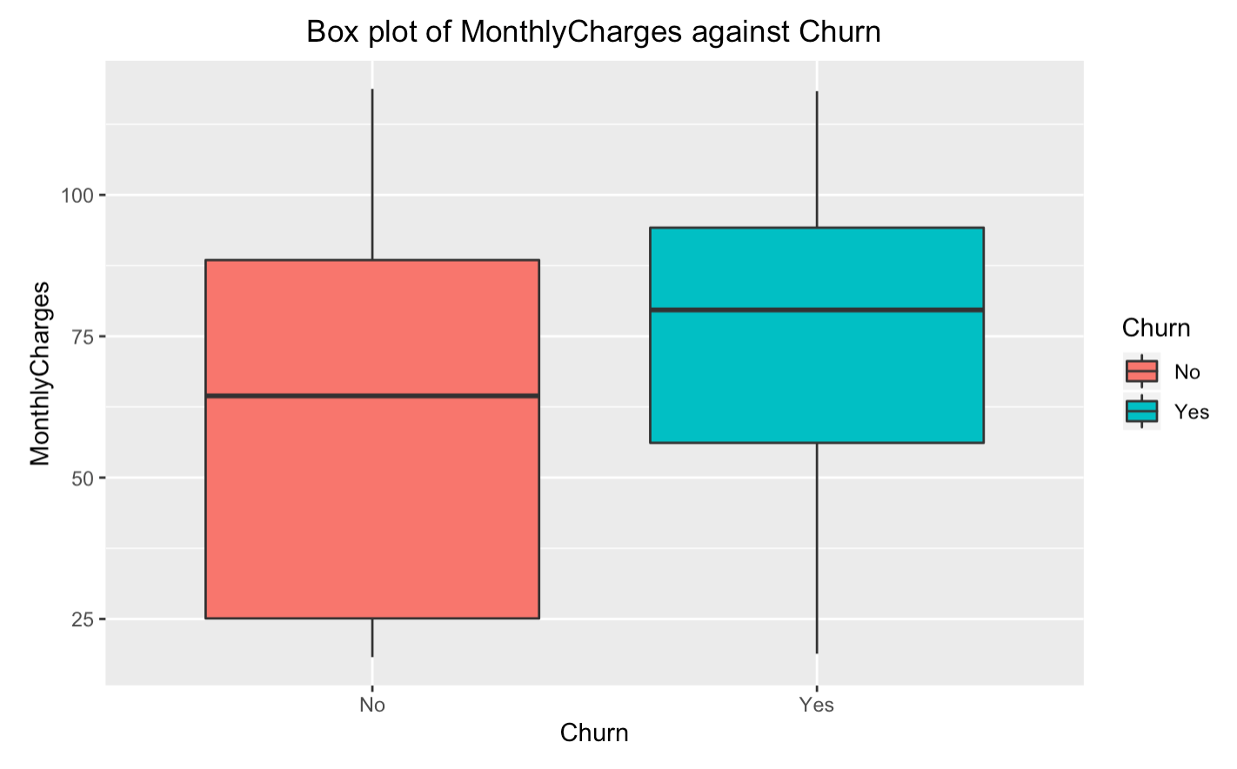
K-S Test: (Monthly Charges)
Let look at contract attributes
Do the lost customers pay more each month than the loyal customers?
if customer retention and customer churn come from the same distribution?
Assumptions
The null hypothesis is both samples are randomly drawn from the same (pooled) set of values.
The two samples are mutually independent.
continuous variables
It’s not normal distribution
Notes:
The first of the nonparametric methods I implemented with this dataset dealt with the Monthlycharge.
I wanted to run a test to see if there any difference in monthly charge between customer retention and customer churn. To do this, I first checked their distributions with density and box plot, which do not follow the normal distribution and have different scale and location. Using Kolmogorov-Smirnov test, I was able to see if Monthlycharge comes from a specified distribution.

Slide 10
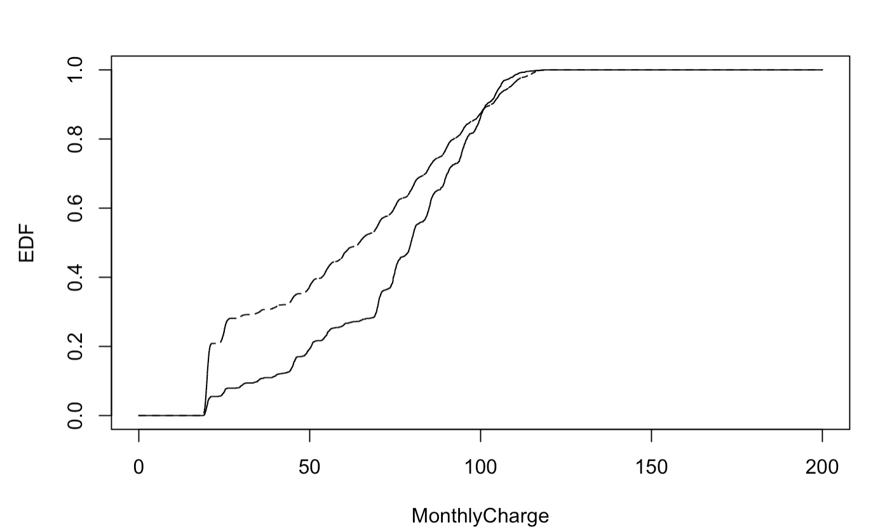
K-S Test: (Monthly Charges)
Ho: The data comes from the same distribution.
Ha: The data dot not comes from the same distribution.
K-S test D = 0.25, p-value < 2.2e-16
Notes:
The K-S test gives us the test statistic of .25 with small p value, which is less than the significant level of .05. so, we conclude that customer retention and customer churn for monthly charge do not come from the same distribution.

Slide 11
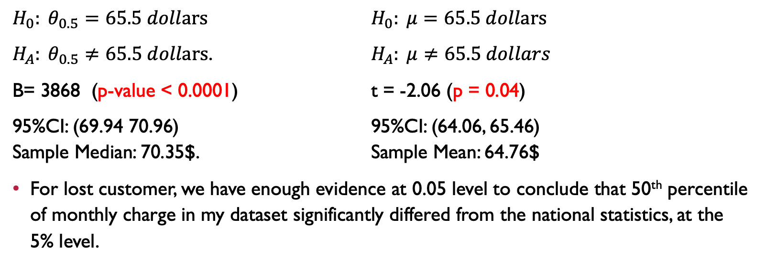
Sign Test: (Monthly Charges) If my data match up with national averages 65.5?
$H_{0}: θ_{0.5}=65.5 dollars$ $H_{0}: μ=65.5 dollars$
$H_{A}: θ_{0.5}≠65.5 dollars$. $H_{A}: μ≠65.5 dollars$
B= 3868 (p-value < 0.0001) t = -2.06 (p = 0.04)
95%CI: (69.94 70.96) 95%CI: (64.06, 65.46) Sample Median: 70.35$. Sample Mean: 64.76$
For lost customer, we have enough evidence at 0.05 level to conclude that 50th percentile of monthly charge in my dataset significantly differed from the national statistics, at the 5% level.
Notes:
For monthly charges. I also use sign test to see If my data match up with national averages 65.5 for monthly charge ?
I tried the both one-sample t-test and sign test saw a similarly strong evidence monthly charge differed from the national statistics,
For CI intervew, these two test are very different. To fully rely on the t-test, however, I would have to make sure each monthly charge is normally distributed,

Slide 12
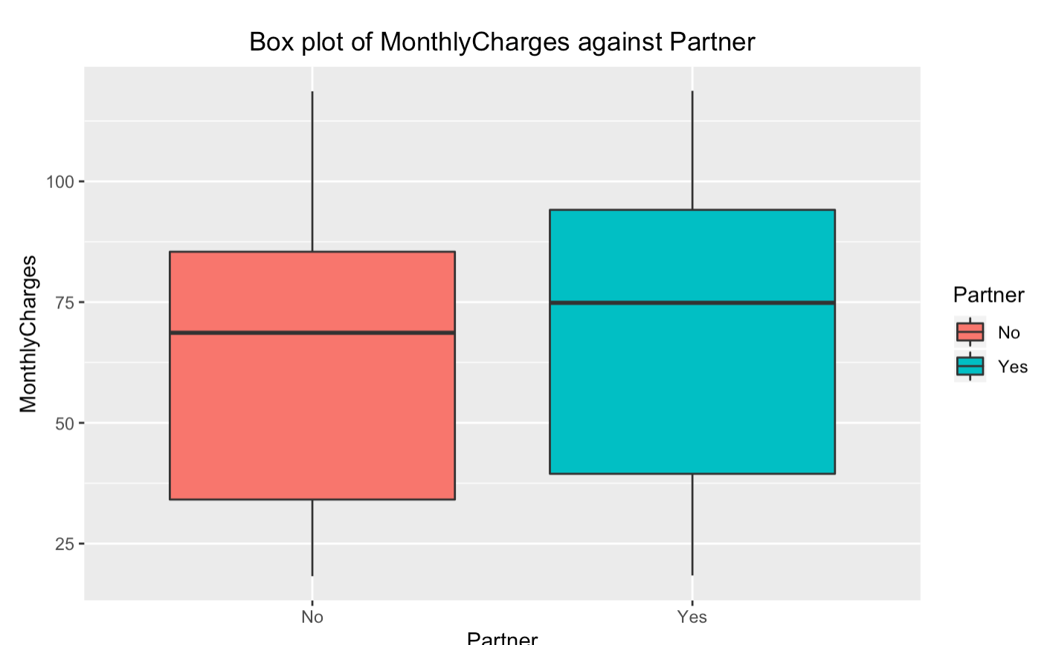
Wilcoxon Rank Sum Test: (Monthly Charges by Partner)
What affects monthly charge?
Would having partner be higher for Monthly Charge?（ex: The more people need high-speed Interne）
Assume:
The two populations have equal variance or spread
The two samples are independent of one another
Notes:
What is even worse than having churn is not knowing why customers churned. The monthly charge for losing customers is relatively high. What is the reason for that? We already know partner has association with churn, I was interested in knowing if monthly charge differs among partner. Because many users sharing the same connection can affect Internet speeds, maybe cost more money to upgrade the internet speed. By looking at box plot, our assumption are met

Slide 13
Wilcoxon Rank Sum Test: (Monthly Charges by Partner)
H0: The two populations are equal versus. Vs. Ha: The two populations are not equal.
W = 6954306, p-value < 2.2e-16 t = 8.2243, p -value = 2.324e-16
95% CI: (4.25, 6.05) 95% CI: (4.48, 7.29)
Sample Diff: 5.1dollars mean of x : 67.85
mean of y: 61.96
We notice the p-value is a less than 0.05. Based on this result, we reject Ho and conclude Ha.
That is, we have enough evidence at 0.05 level to conclude that two populations are not equal.
To be more specific , having a partner will increase monthly charge.
Notes:
I wanted to use a Rank Sum test to see if there is difference between having partner and without partner. The Rank Sum Test gave us the test statistic with small p-value, we conclude two populations are not equal. To be more specific , having a partner will increase monthly charge. When two-sample t-test, the similar result is achieved. And CI for these two test are pretty close. Again ,we have to make sure each monthly charge is normally distributed,

Slide 14
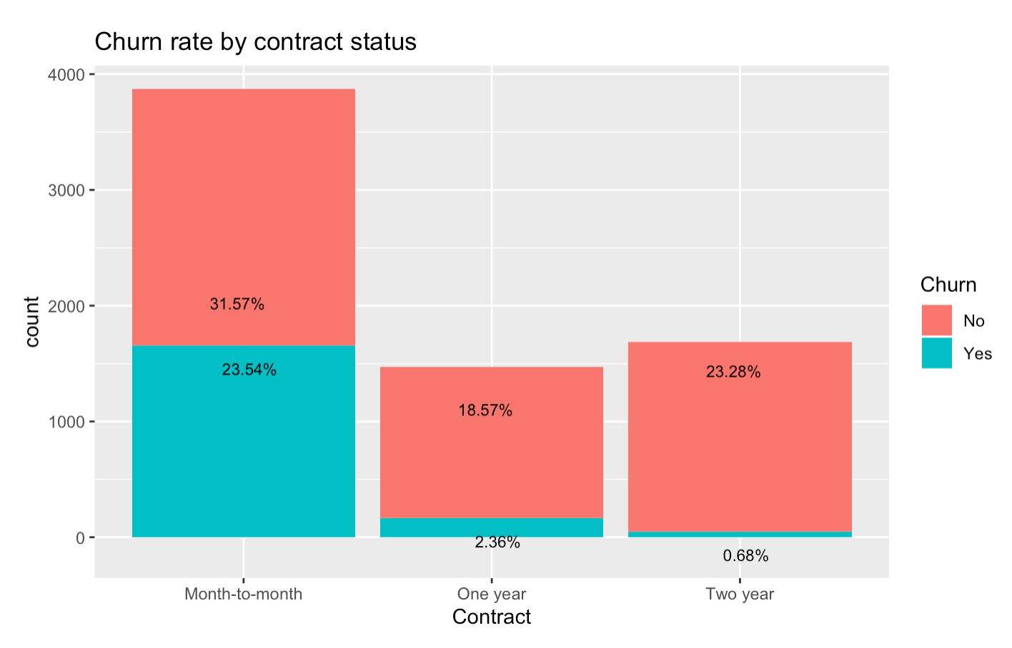
Does the contract have any effect on customer churn?
The churn rate of month-to-month contract customers is much higher than the longer contract customers. Customers who are more willing to commit to longer contracts are less likely to leave
Is Monthlycharge the same between different contracts?
Did the customer leave because of higher monthly charges?
Does not offer discounts for short term contracts?
Notes:
Since my data analysis was focused on the reason behind the costumer churn, I also wanted to compare the monthly charge variable between the churn and contract.
. First, as we would be expected, The churn rate of month-to-month contract customers is much higher than the longer contract customers.
Personally, I think the price concessions are the main reason for me to sign a long-term contract, so, I am interested in exploring the relationship between contract and monthlycharge in term of variability and location shift.

Slide 15
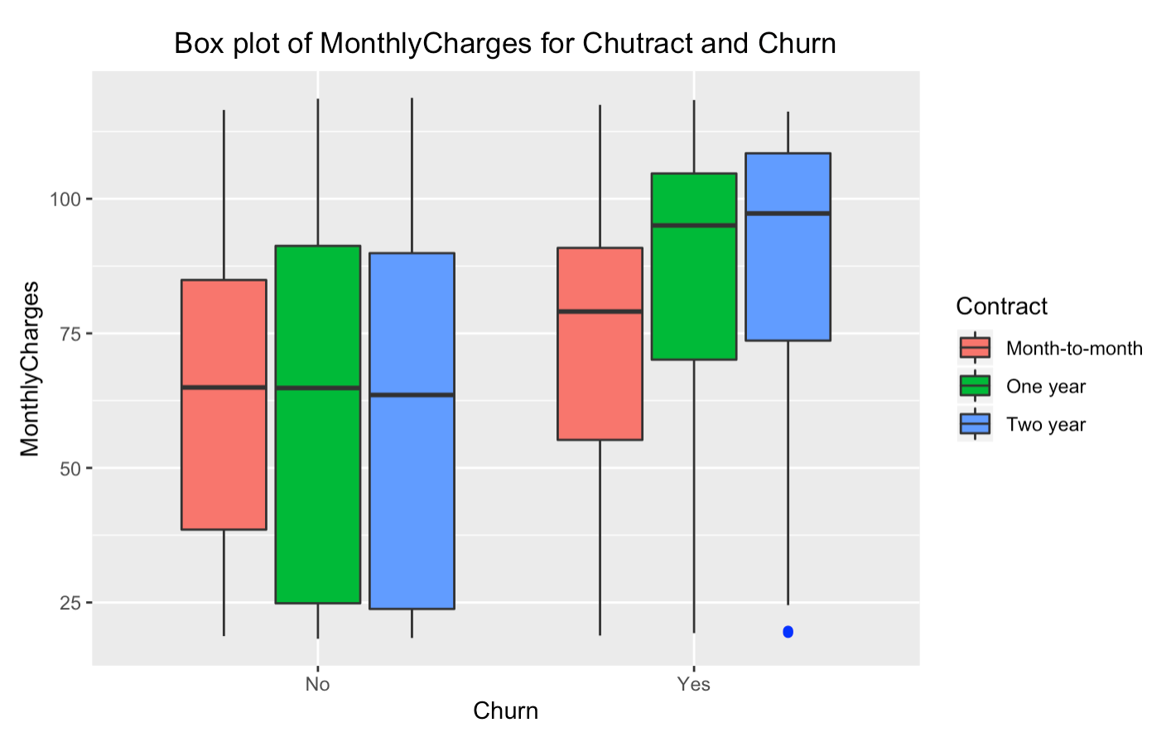
Violation: not normal distribution
For the loyal remaining customers:
Is the monthly charge the same for all different contract?
What kind of price can better retain customers?
Assume:
Independent Samples
Equal median
Equal shape for
one- and two-year contract

Slide 16
Ansari-Bratest Test: One Year Vs. Month-to-month (Is there much difference between a monthly contract and an annual contract?)
H0: Two population distribution function correspond to the two sample are idd
H_{A} : One-year contract has greater variability than monthly contract.
Ansari-bratest Test
Normal-theory F Test
p-value < 0.0001
AB = 1052584
Both tests gave P values less than 0.0001
We reject Ho and to conclude that the variability of a One-Year contract is greater than that of a monthly contract.
F = 1.2902
p-value = 9.011e-08
ratio of variances 1.29
Notes:
I used the Ansari-Bradley and F test to check if monthly contract and an annual contract are identically distributed. I assume that the median of monthly charge for different contracts are the same in customers retention, however they are not normal distribution due to the left skewed. Both parametric and nonparametric test gave the small p-value. We conclude that one year has greater variability than monthly contract

Slide 17
Wilcoxon Rank Sum Test: (Two Year Vs. One Year) Is the monthly charge for one year and two years the same?
H0: The two populations are equal versus. Vs. Ha: The two populations are not equal.
Rank Sum Test:
Two Sample T-test:
W = 1094252, p-value = 0.2695
95%CI: (-0.25 1.05)
difference in location : 0.3
Since 0.2695>0.05, we retain H0; we do not have enough evidence to conclude at 0.05 level that the two populations are not equal.
t = 1.9842, p-value = 0.04733
95%CI: (0.029, 4.8)
We reject H0 and conclude the two populations are not equal.
Notes:
. Second, I used Rank-Sum Test to see if there any difference in in One-Year and Two-Year contract. This gave big p-value .27, we do not have enough evidence to conclude the two populations are not equal.
When comparing to the t-test, the p-value is relatively small, we conclude two populations are not equal, but it less reliable than the A-B results due to the abnormal tails.

Slide 18
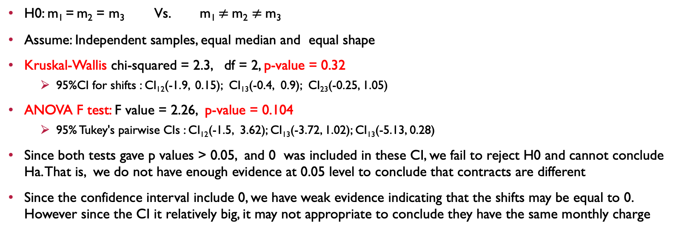
Kruskal–Wallis Test: (Month-to-month Vs. Two Year Vs. One Year) Is the monthly charge the same for all different contract?
H0: m₁ = m₂ = m₃ Vs. m₁ $≠$m₂ $≠$m₃
Assume: Independent samples, equal median and equal shape
Kruskal-Wallis chi-squared = 2.3, df = 2, p-value = 0.32
95%CI for shifts : CI₁₂(-1.9, 0.15); CI₁₃(-0.4, 0.9); CI₂₃(-0.25, 1.05)
ANOVA F test: F value = 2.26, p-value = 0.104
95% Tukey's pairwise CIs : CI₁₂(-1.5, 3.62); CI₁₃(-3.72, 1.02); CI₁₃(-5.13, 0.28)
Since both tests gave p values > 0.05, and 0 was included in these CI, we fail to reject H0 and cannot conclude Ha. That is, we do not have enough evidence at 0.05 level to conclude that contracts are different
Since the confidence interval include 0, we have weak evidence indicating that the shifts may be equal to 0. However since the CI it relatively big, it may not appropriate to conclude they have the same monthly charge
Notes:
Third, I wanted to compare monthly charge for all different contract in customer retention. Using Kruskal-Wallis and ANOVA F test, both tests gave p values > 0.05. we do not have enough evidence to conclude that contracts for monthlycharge are different. Since we have already conclude that one year has greater variability than monthly contract,
In order to verify the results of K_W test, I developed the nonparametric approach to find confident interval for these shifts, which are CI₁₂(-1.9, 0.15), CI₁₃(-0.4, 0.9) and CI₂₃(-0.25, 1.05) (1=month-to-month, 2=One year, 3= Two year).
Since the confidence interval include 0, we have weak evidence indicating that the shifts may be equal to 0. However since the CI it relatively big, it may not appropriate to conclude they have the same monthlycharge

Slide 19
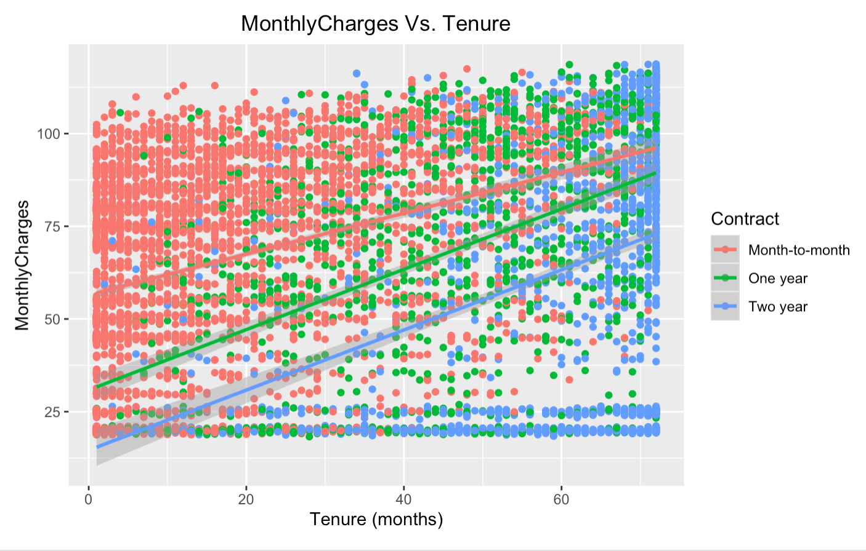
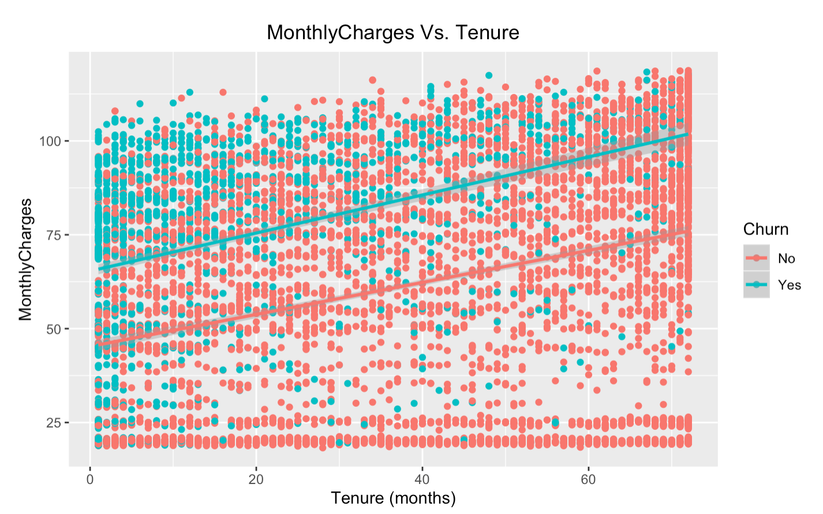
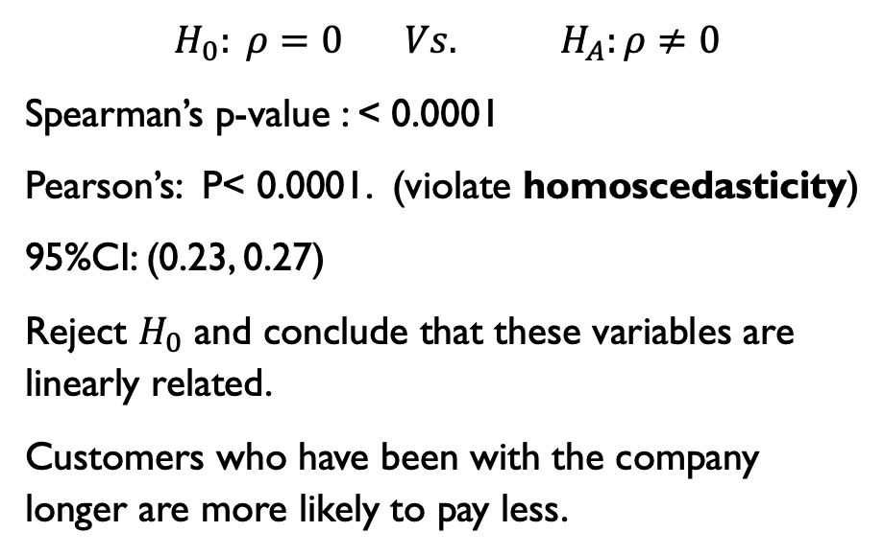
Association: Monthlycharges Vs. Tenure
$$H_{0}: ρ=0 Vs. H_{A}:ρ≠0$$
Spearman’s p-value : < 0.0001
Pearson’s: P< 0.0001. (violate homoscedasticity)
95%CI: (0.23, 0.27)
Reject $H_{0}$ and conclude that these variables are linearly related.
Customers who have been with the company longer are more likely to pay less.
Notes:
With the three numeric variables I used throughout this analysis, I also wanted to see if monthly charges has any association with tenure. To to this, I made scatterplot, and found that there is a fairly strong, positive, linear association between monthly charges and tenure. To verify this result, I ran Spearman’s and Pearson correlation test, both tests concluded that these two variables are linearly related. Again, Pearson correlation test may less likely reliable than Spearman’s test due to the heteroscedasticity (variance)

Slide 20

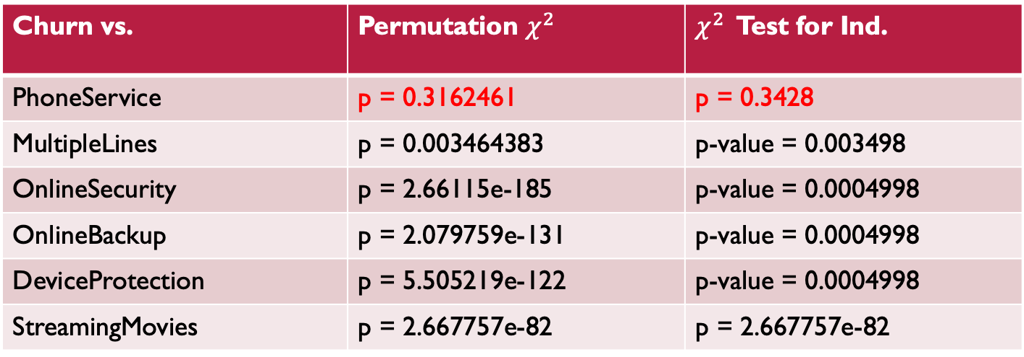
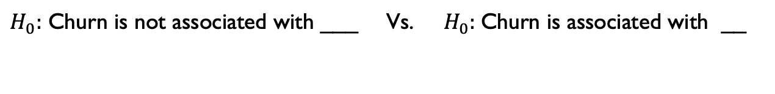
Permutation $χ^{2}$ Test: Churn Vs. Categorical Variables
Let look at service attributes
$H_{0}:$ Churn is not associated with ___ Vs. ${ H}_{0}:$Churn is associated with __
Churn vs. | Permutation $χ^{2}$ | $χ^{2}$ Test for Ind.
PhoneService | p = 0.3162461 | p = 0.3428
MultipleLines | p = 0.003464383 | p-value = 0.003498
OnlineSecurity | p = 2.66115e-185 | p-value = 0.0004998
OnlineBackup | p = 2.079759e-131 | p-value = 0.0004998
DeviceProtection | p = 5.505219e-122 | p-value = 0.0004998
StreamingMovies | p = 2.667757e-82 | p = 2.667757e-82
Notes:
look at service attributes, I decided to determine if there exists a correlation between the churn and the services customers chooses. Phoneservice is not associated with churn

Slide 21
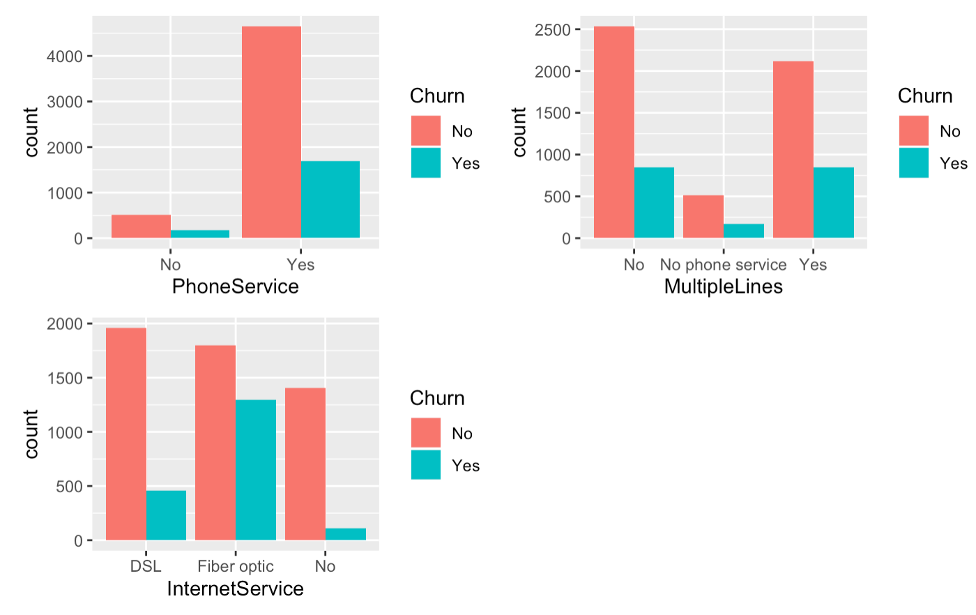
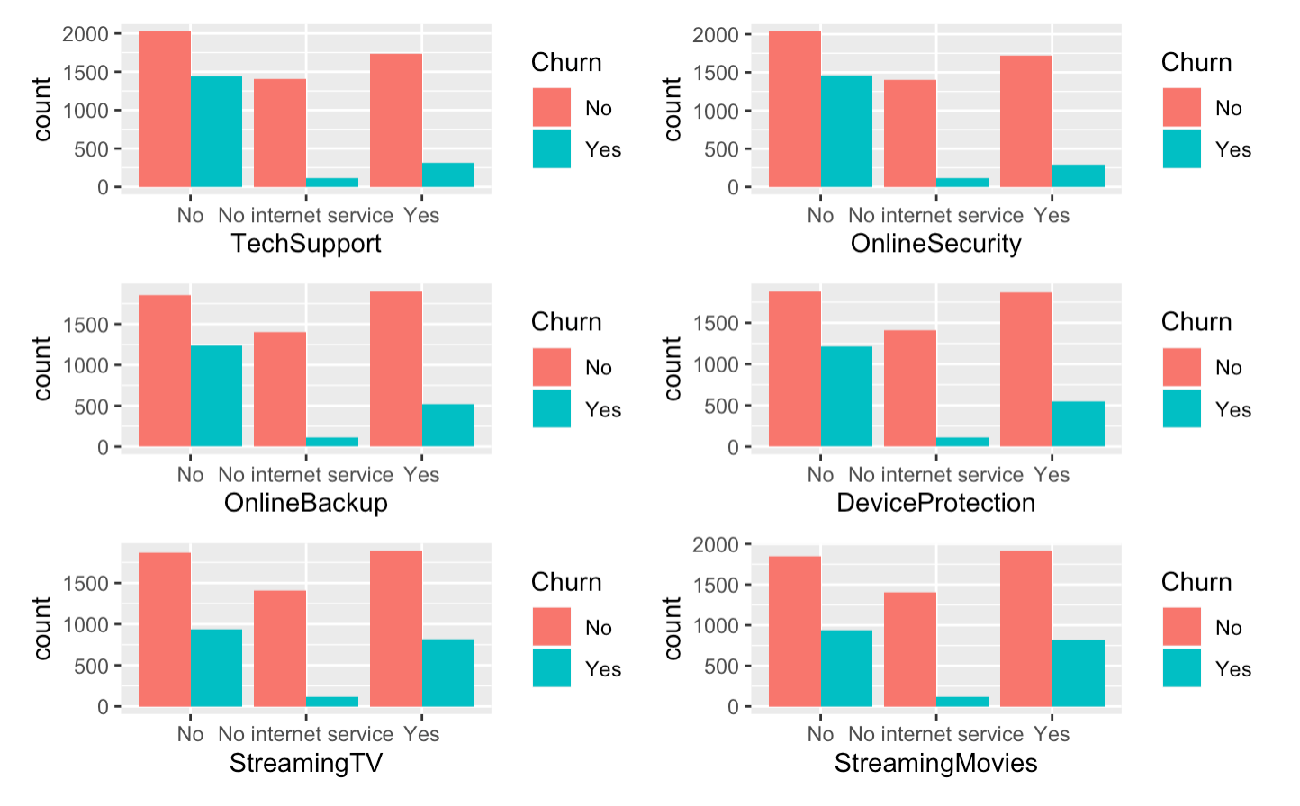
Phone And Internet Service
Other Subscription Services
Notes:
From the graph, Indicators such as PhoneService and MultiLines seem to have had little impact
Customers with internet service, in particular, fiber service, are more likely to churn. People without subscription services (such as Tech support, online backup) are more likely to churn

Slide 22
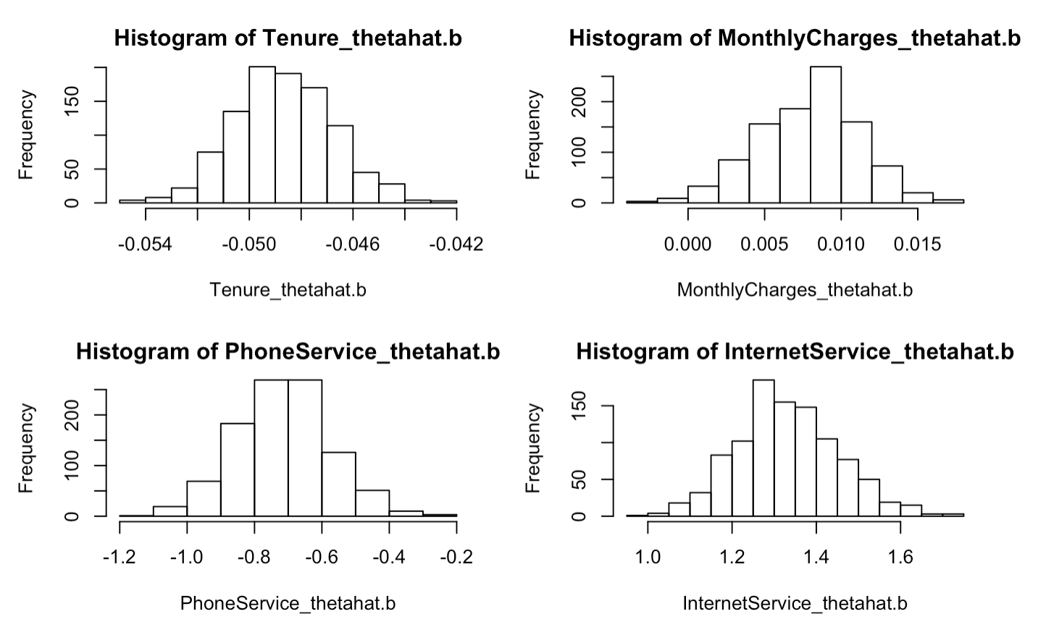
Bootstrap
Logistic Regressions are used when we want to find the scale effect of how variables can affect a dependent variable. (x = tenure, InternetService, Monthlycharge and phone service, y = churn)
 | coeff | 95%CI | Odd Ration
tenure | e^{-0.049} = 0.95 | (-0.052, -0.045) | (0.95, 0.96)
MonthlyCharges | e^{0.0076} =1 | (0.00083, 0.014 ) | (1, 1.02)
InternetService_Fiber optic | e^{1.34} = 3.82 | (1.10, 1.59 ) | (3, 4.9)
PhoneService | e^{-0.71} = 0.5 | (-0.97, -0.44 ) | (0.38, 0.65)
Notes:
Finally I wanna see Logistic Regressions are used when we want to find the scale effect of how variables can affect a dependent variable.
Where on the left you can see the CI for ceff from bootstrap, also we can see from the odd ration. The ci for phonesservie are small, intersecive for fiber is big,
That's consistent with what we've been found before,
The odd ration is 0.95 with 95% CI of (0.95, 0.96). Because this CI dose not contain 0, we know that the odd ration is statistically significant.
Thus, we estimate that the for every additional month in tenure for customer, the odds of having a customer churn decrease multiplicatively by 0.95

Slide 23
Conclusion
Features of users with high churn rate:
User attributes： senior citizen and customer who has dependents and partners are more likely to churn
Service attributes：Customers with internet service, in particular, fiber optic service is more likely to churn. People without subscription services (such as Tech support, online backup) are more likely to churn
Contract attributes：Customers with monthly contracts, electronic check, short tenure(especially in the first 6 months), monthly charge(70-100) are more likely to churn.
Recommendations:
User attributes: Customized services, such as family packages for the senior citizens, and users who have no dependencies and partner.
Service attributes: For new customers, a half-year discount is given to pass the peak period of user loss. On the other hand, the new customers are promised free network upgrades and free TV, movie and other monthly services to improve user stickability. For optical fiber users, the focus is to improve the network experience
Contract attributes: For monthly contract users, the annual contract payment discount activity is launched to convert monthly contract users into annual contract users to achieve a higher user retention rate.
Since the longer the contract period, the less likely to lose customers, However, for retained loyal customers, the monthly charge for a One-Year and Two-Year contract are equal, so the monthly charge between (63.55, 64.5) can better to retain the customer

Slide 25
references
BlastChar. “Telco Customer Churn.” Kaggle, 23 Feb. 2018, www.kaggle.com/blastchar/telco-customer-churn.

